Slide 1
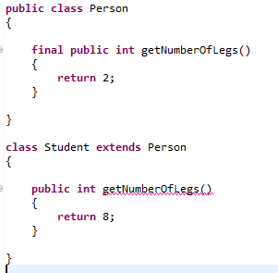
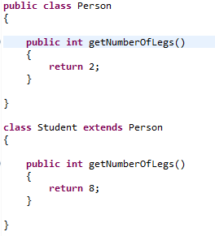


Final Methods
We can declare some or all of a class's methods final. You use the final keyword in a method declaration to indicate that the method cannot be overridden by subclasses.
We might wish to make a method final if it has an implementation that should not be changed and it is critical to the consistent state of the object.
Methods called from constructors should generally be declared final. If a constructor calls a non-final method, a subclass may redefine that method with surprising or undesirable results.

